Slide 1
If someone you know has a problem with crystal meth...
...Crystal Meth Anonymous can help.

Slide 2
What is Crystal Meth Anonymous?
CMA is a fellowship of men and women who share their experience, strength and hope with each other, so they may solve their common problem and help others to recover from addiction to crystal meth.
There are no dues or fees for CMA membership; we are self-supporting through our own contributions. The only requirement for membership is a desire to stop using. CMA is not allied with any sect, denomination, politics, organization or institution; does not wish to engage in any controversy; and neither endorses nor opposes any causes.
Our primary purpose is to lead a sober life and to carry the message of recovery to the crystal meth addict who still suffers.
CMA started in 1994 in West Hollywod and now has more than 600 meetings every week around the world.

Slide 3
Crystal Meth Anonymous Does Not:
Operate hospitals or recovery homes for addicts
Solicit or coerce others to join
Engage in or sponsor research on addiction
Keep membership records or case histories of its members
Make medical or psychological diagnoses
Provide marriage, family, or vocational counselling
Provide monetary or social assistance
Provide or participate in primary drug prevention education
Accept money for its services or funding from any public or private agencies

Slide 4
How Does CMA Work?
Like other Twelve Step fellowships, CMA’s approach to recovery consists of three basic components:
Meetings and Fellowship
We attend meetings regularly to learn how others have stayed
sober and to find support in our efforts to deal with life’s
challenges and the emotions that come with them.
Sponsorship and Stepwork A sponsor is another recovering addict whom we choose to offer us guidance in working the Twelve Steps of CMA.
Service Commitments We volunteer to be of service by helping other addicts. These service comittments help us attend meetings regularly, connect with others in the fellowship and strenghten our sobriety.

Slide 5
How is CMA Different From Other Twelve Step Fellowships?
We have found that we relate best to other crystal meth addicts because they understand the darkness, paranoia and compulsions of this particular addiction, as opposed to the effects of other drugs.
Many of us can relate to the extended length and intensity of crystal meth’s effects. Some of these include :
Hypersexual activity
Compulsive cleaning
The endless tinkering or destruction of our belongings
The insanity and psychosis that can accompany the high…other mental health concerns
Seemingly bottomless drop into depression that makes us desperate to use again

Slide 6
Recovery Begins
Recovery begins with the addict’s recognition that they are powerless over their addiction and that their life has become unmanageable
The foundation of our fellowship is regular attendance at meetings where members discuss how they achieved sobriety and a new outlook on their way of living
We recommend a program of recovery which includes the Twelve Steps of CMA

Slide 7
Membership Survey
Official Survey report released in November 2014
Respondents primarily from United States; also received responses from England, Australia and Canada
Report can be found online at crystalmeth.org
Survey is not statistical analysis; rather a snapshot

Slide 8
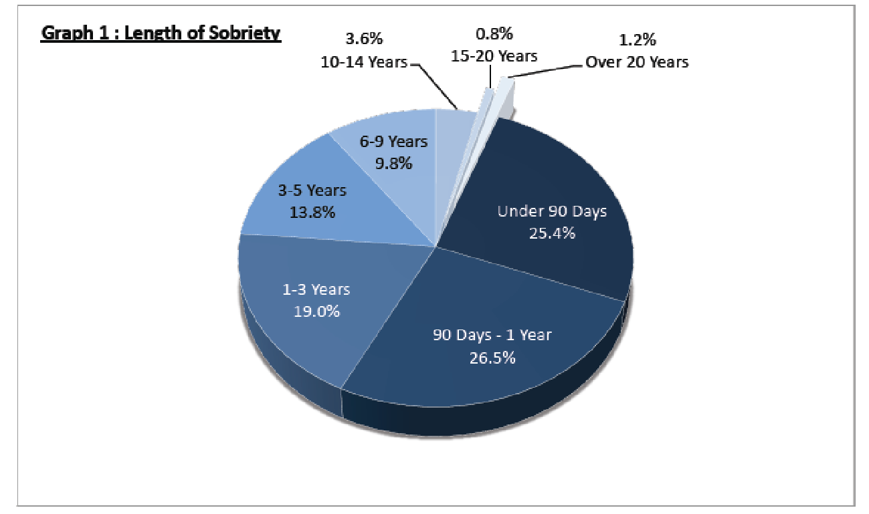
Membership Survey

Slide 9
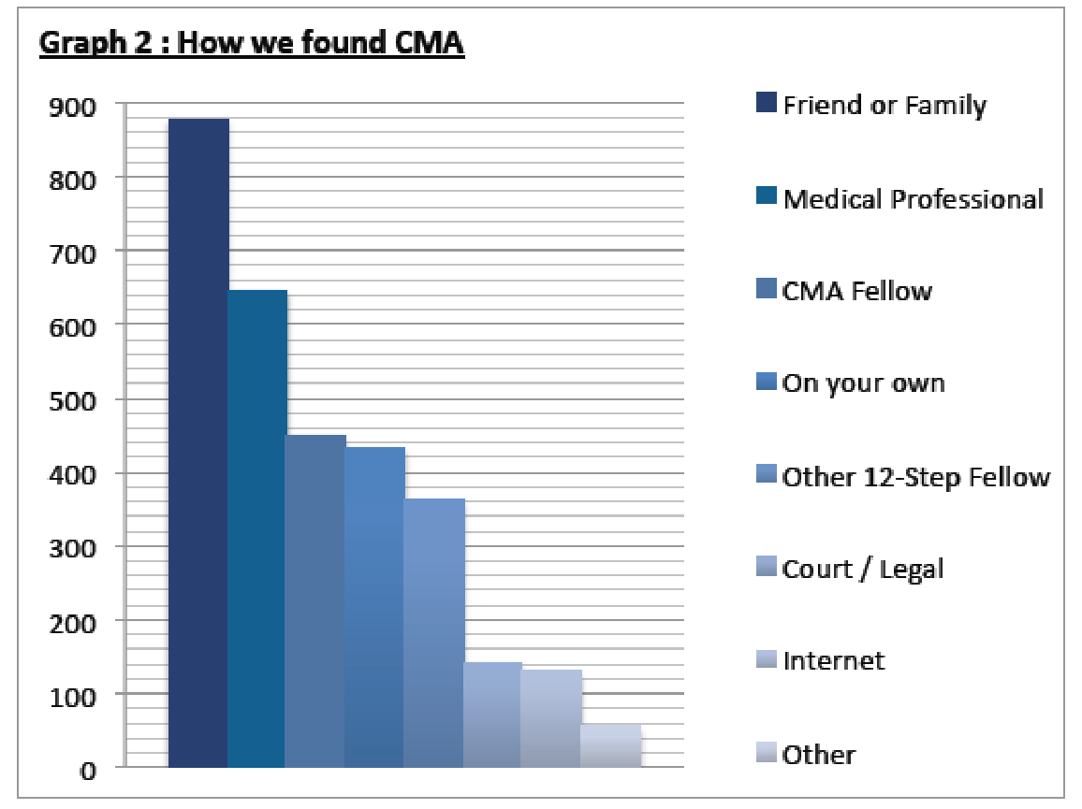
Membership Survey
Note : multi-response was permitted

Slide 10
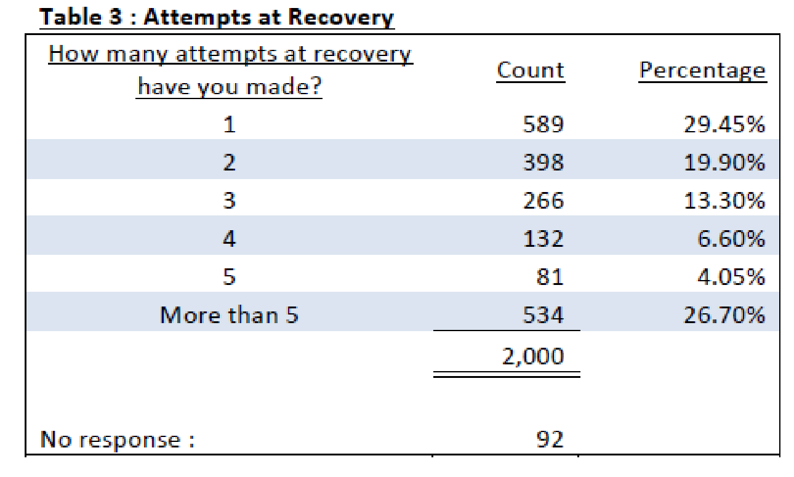
Membership Survey

Slide 11
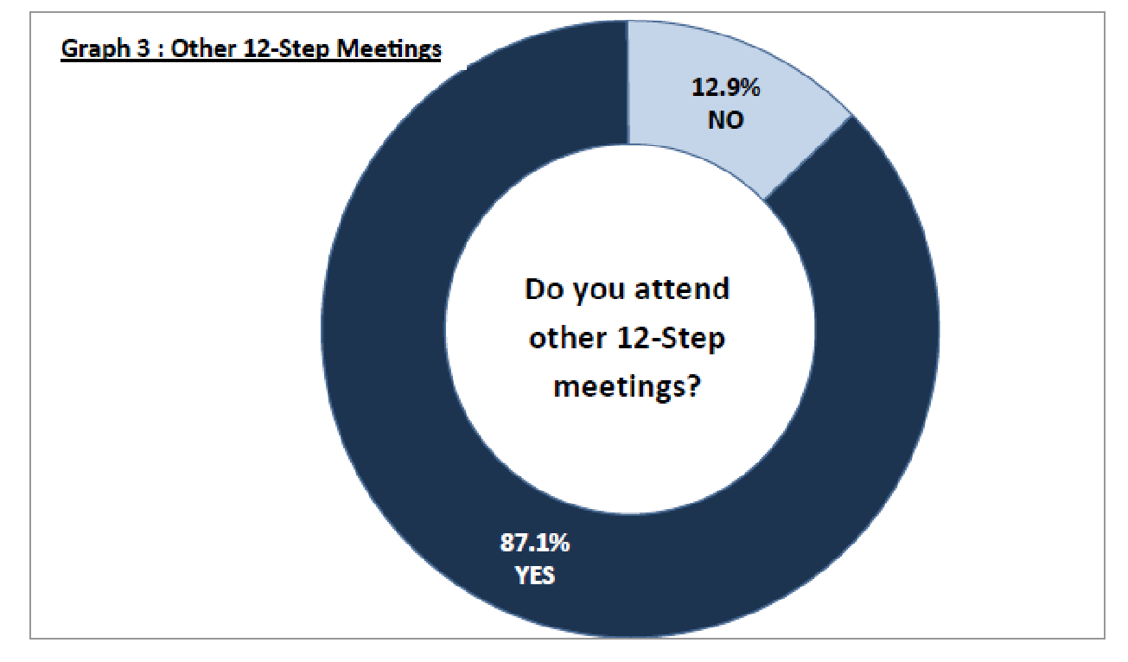
Membership Survey

Slide 12
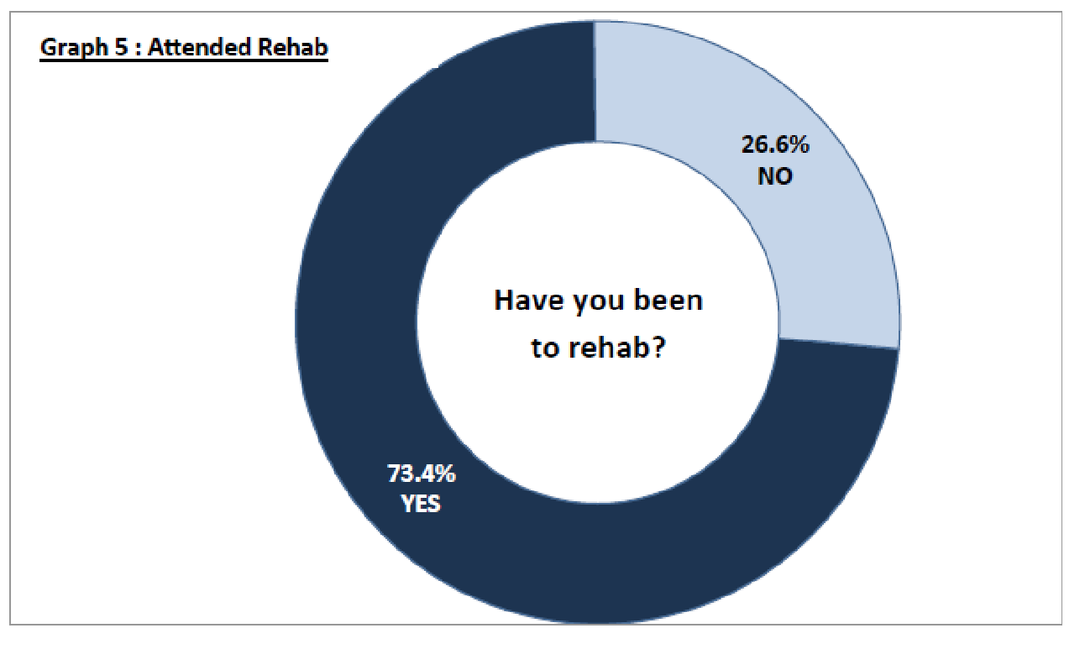
Membership Survey

Slide 13
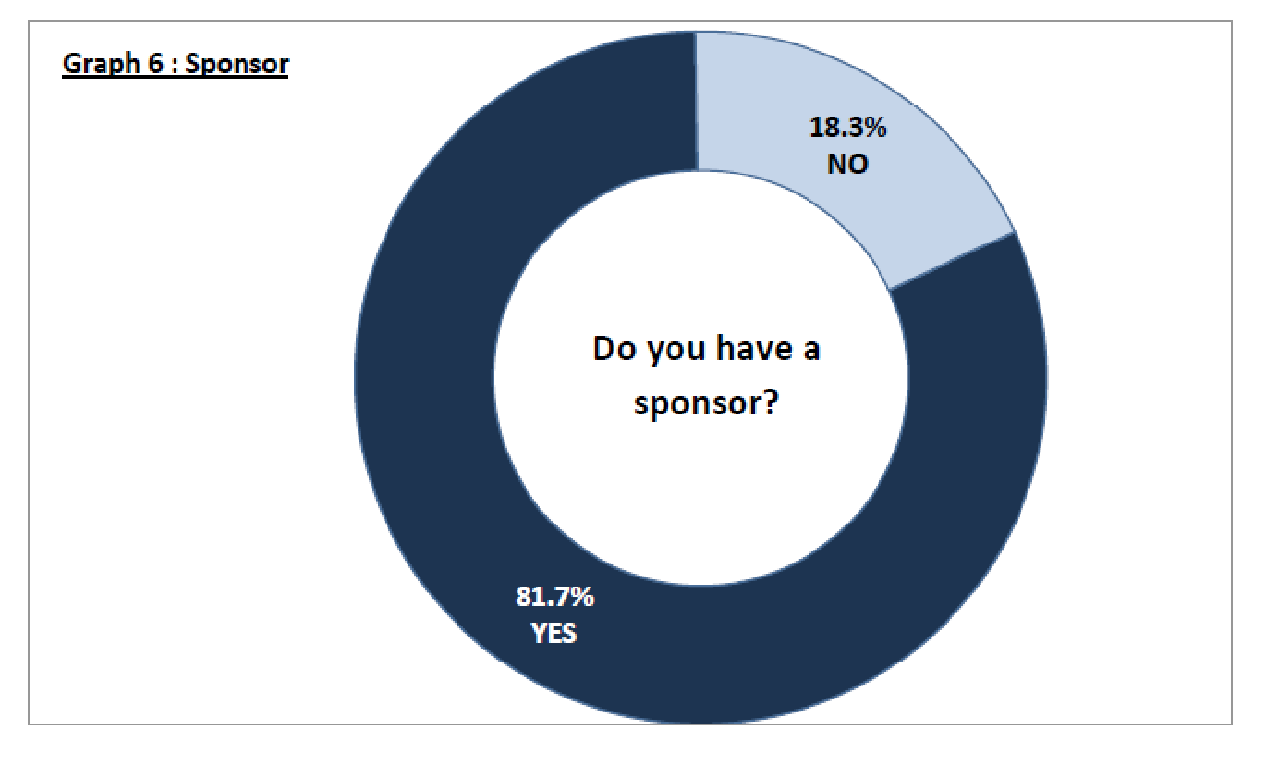
Membership Survey

Slide 14
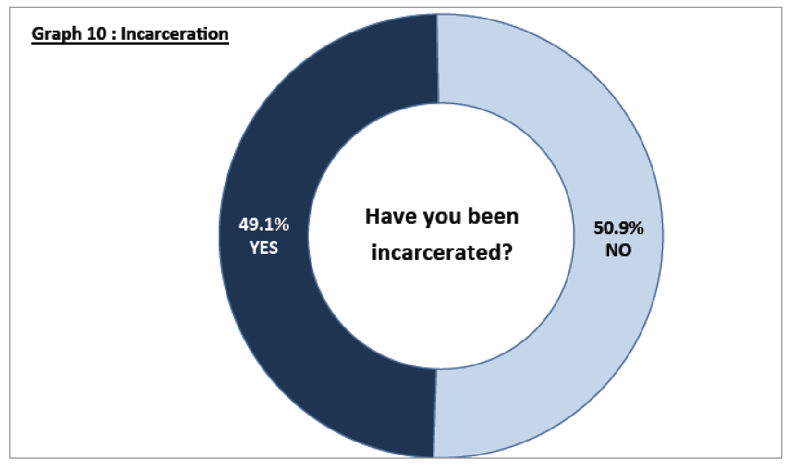
Membership Survey

Slide 15
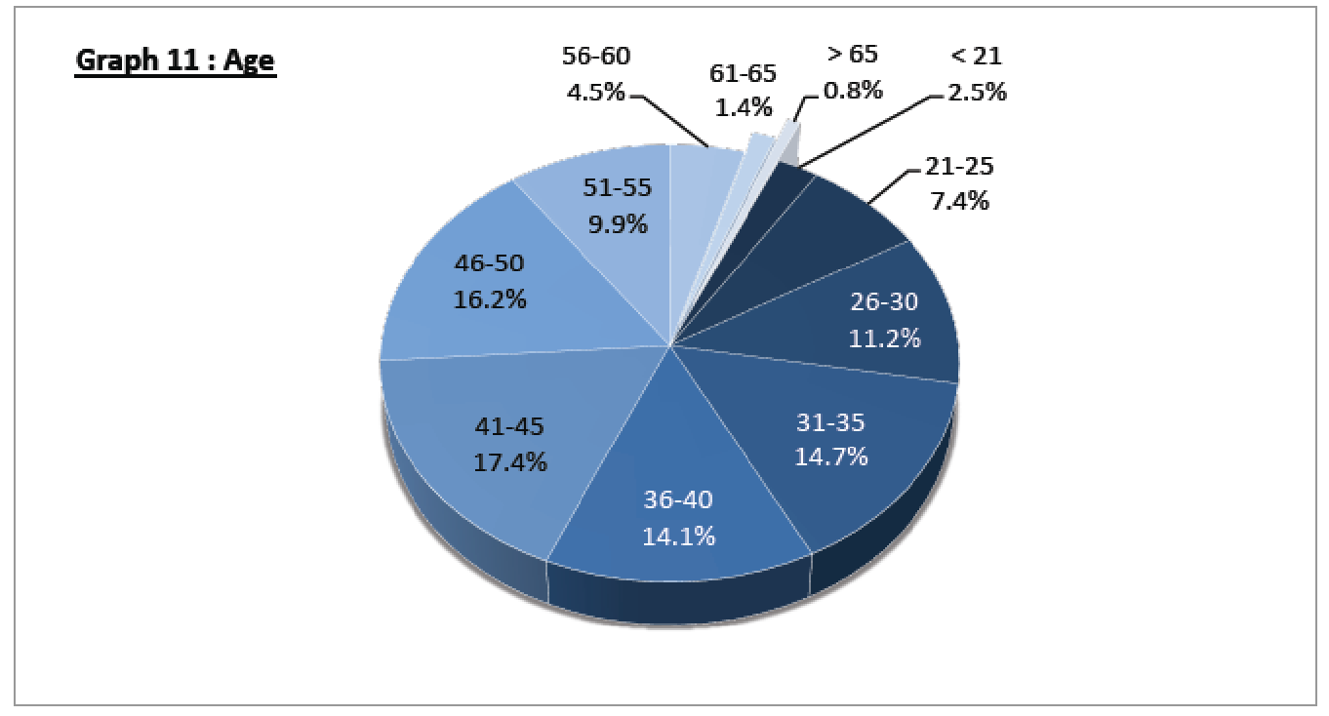
Membership Survey

Slide 16
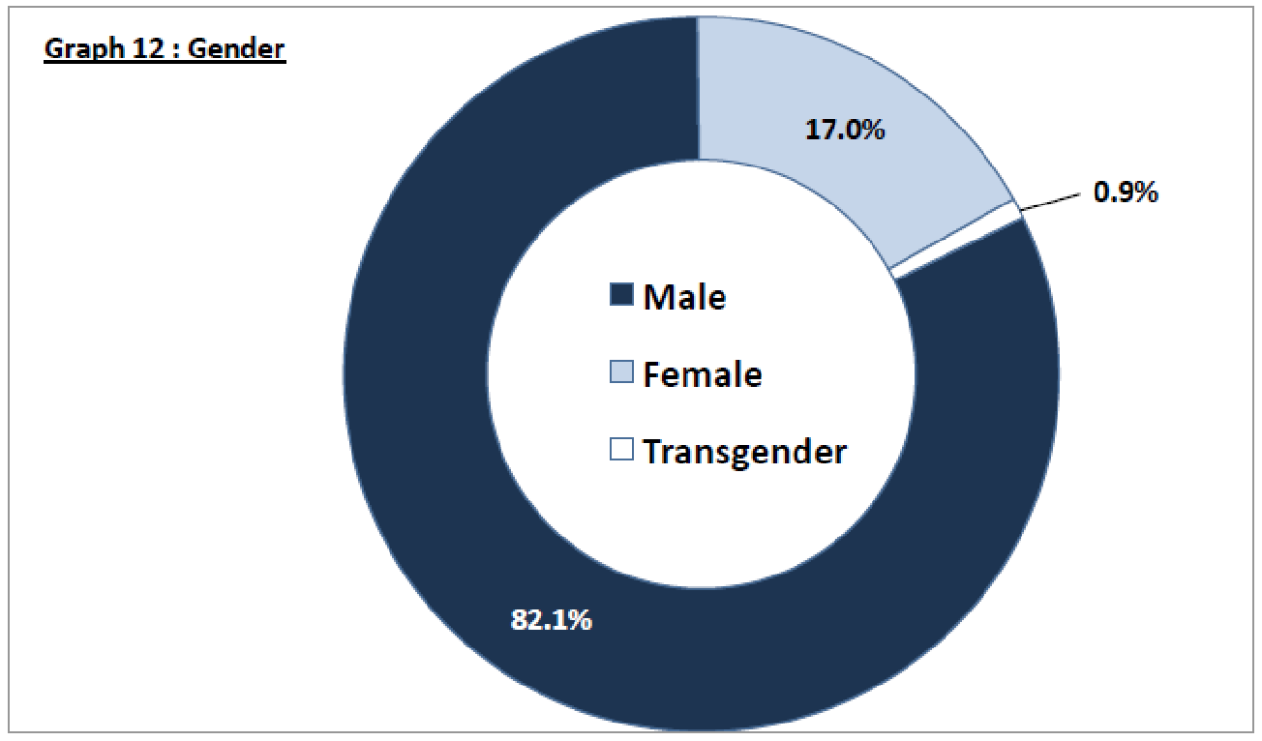
Membership Survey

Slide 17
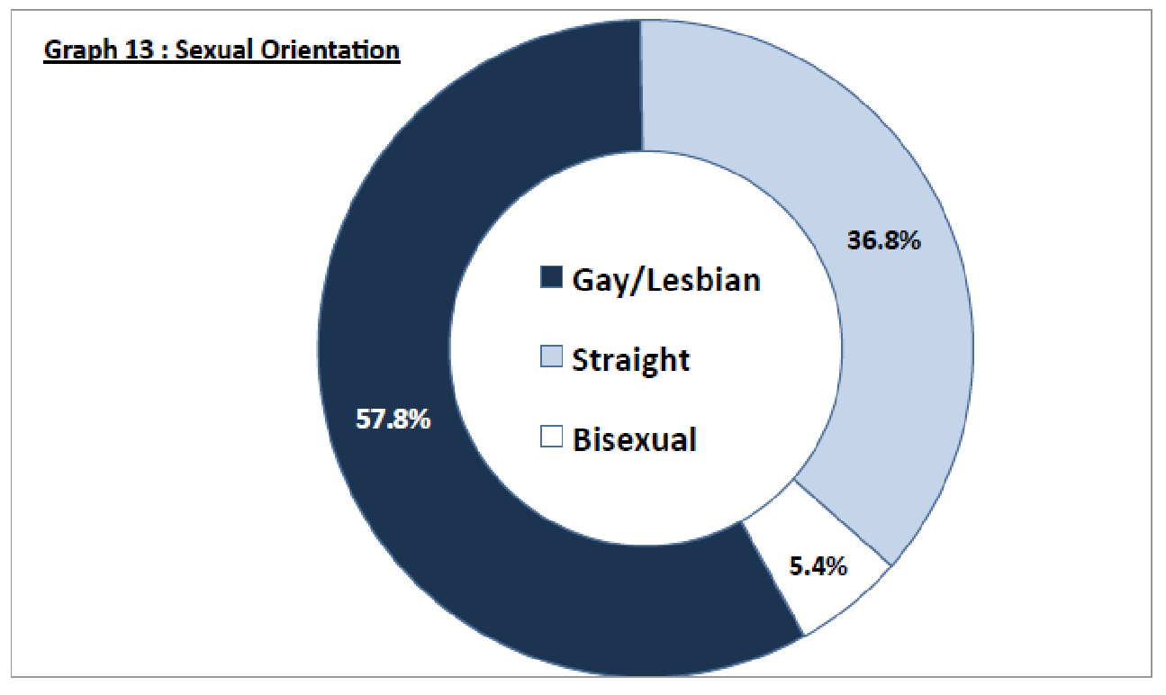
Membership Survey

Slide 18
Providing Meetings for Addicts in Facilities and Institutions
The CMA Hospitals and Institutions (H&I) Committee can provide meetings and literature to various facilities and institutions.
An H&I meeting is a CMA meeting that takes place inside jails, treatment centers, hospitals, recovery homes, sober living environments or any other institution or facility where access to CMA meetings is limited or restricted. We use Conference approved literature and provide this literature to those attending our meetings.
There are many formats that can be used at an H&I meeting. Generally, there is a panel with a minimum of two crystal meth addicts sharing their personal experience with recovery and staying sober through the Twelve Steps. In many ways, H&I meetings resemble regular CMA meetings including the celebration of milestones in sobriety.

Slide 19
Providing Information to Friends and Family
The CMA Hospitals and Institutions (H&I) Committee can provide meetings and literature to various facilities and institutions.
Addicts suffer from a progressive and potentially fatal disease.
Modern medical thinking is that addiction is not a weakness, a lack of willpower nor a moral failing.
Friends and family often feel the effects of addiction, too.

Slide 20
How to Contact CMA
Contact Local CMA
(Local PI&O Contact Information)
(Local H&I Contact Information)
(Local Other Contact Information)
Contact CMA General Services
www.crystalmeth.org
855.METH.FREE (855.638.4373)

